Slide 1
Metrics for Process and Projects
.

Slide 2
What is Software metrics?
Software metrics (process and project) are quantitative measures. Measurement can be applied:
To the software process with the intent of improvement
To assist in estimation, quality control, productivity assessment, and project control
To help assess the quality of technical work products
To assist in tactical decision making as a project proceeds

Slide 3
Why we need to measure?
To characterize in an effort to gain an understanding of process, products, resources and environments and to establish baselines for comparisons with future assessments.
To evaluate to determine status with respect to plans
To predict by gaining understanding of relationships among processes and products and building models of these relationships
To improve by identifying roadblocks, root causes, inefficiencies, and other opportunities for improving product and process performance.

Slide 4
Metric and Indicator
A metric is a quantitative measure of the degree to which a system, component, or process possesses a given attribute.
An indicator is a metric or combination of metrics that provide insight into the software process, a software project, or the product itself.
A software engineer collects measures and develops metrics so that indicators will be obtained .

Slide 5
Process Metrics
Process metrics are collected across all projects and over long periods of time.
Process metrics provide a set of process indicators that lead to long-term software process improvement
The only way to know how/where to improve any process is to
Measure specific attributes of the process
Develop a set of meaningful metrics based on these attributes
Use the metrics to provide indicators that will lead to a strategy for improvement

Slide 6
Project metrics
Enable a software project manager to
Assess the status of an ongoing project
Track potential risks
Uncover problem areas before they "go critical“
Adjust work flow or tasks

Slide 7
Project metrics
Evaluate the project team's ability to control quality of software engineering work products
Estimate effort and time duration
Every project should measure input, output and result

Slide 8
Use of Project Metrics
The first application of project metrics occurs during estimation
Metrics from past projects are used as a basis for estimating time and effort
As a project proceeds, the amount of time and effort expended are compared to original estimates
As technical work commences, other project metrics become important
Production rates are measured (represented in terms of models created, review hours, function points, and delivered source lines of code)
Error uncovered during each generic framework activity (i.e, communication, planning, modeling, construction, deployment) are measured

Slide 9
Use of Project Metrics
Project metrics are used to
Minimize the development schedule by making the adjustments necessary to avoid delays and mitigate potential problems and risks
Assess product quality on an ongoing basis and, when necessary, to modify the technical approach to improve quality
In summary
As quality improves, defects are minimized
As defects go down, the amount of rework required during the project is also reduced
As rework goes down, the overall project cost is reduced

Slide 10
Summary: Project Metrics
Used by project manager and a software team to adapt project workflow and technical activities.
Metrics collected from past projects used to estimate effort and time.
Project metrics measures: review hours, function points, delivered source lines, errors uncovered during each software
Intent of project metrics is twofold: 1. these metrics are used to minimize the development schedule by making the adjustments necessary to avoid delays and mitigate potential problems and risks.

Slide 11
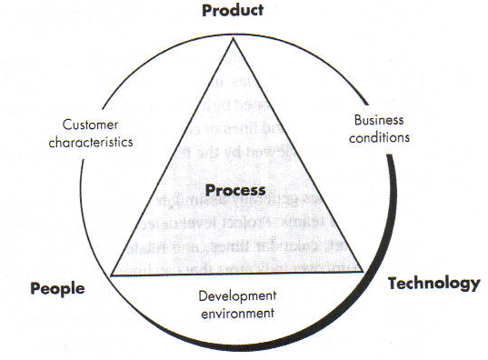
Determinants for Software quality & Organizational Effectiveness
.

Slide 12
Private and Public metric
There are "private and public" uses for different types of process data
Data private to the individual
Serve as an indicator for the individual only
Eg : Defect rates, Errors found during development
Public metric
Defects reported for major software functions
Errors found during formal technical reviews
Lines of code or function points per module/function

Slide 13
Software Measurement
Direct measures
Software process (cost)
Software product (lines of code (LOC), execution speed, defects reported over some set period of time
Indirect measures
Software product (Functionality, quality, complexity, efficiency, reliability, maintainability )
Many factors affect software work, it is difficult (don’t use metrics) to compare individuals/team

Slide 14
Size-Oriented Metrics
Derived by normalizing quality and/or productivity measures by considering the "size" of the software
Metrics include
Errors per KLOC - Errors per person-month
Defects per KLOC - KLOC per person-month
Dollars per KLOC - Dollars per page of documentation
Pages of documentation per KLOC
Opponents argue that KLOC measurements
Are dependent on the programming language
Penalize well-designed but short programs
Cannot easily accommodate nonprocedural languages
Require a level of detail that may be difficult to achieve

Slide 15
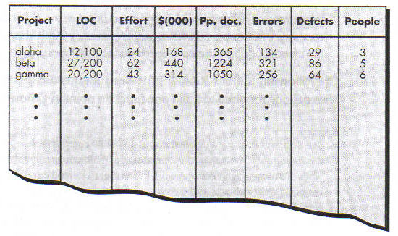

Slide 16
Function-Oriented Metrics
It is a measure of the functionality delivered by the application as a normalization value
Eg. Number of input, number of output, number of files, number of interfaces

Slide 17
Function-oriented Metrics
Function-oriented metrics use a measure of the functionality delivered by the application as a normalization value
Most widely used metric of this type is the function point: FP = count total * [0.65 + 0.01 * sum (value adj. factors)]
Function point values on past projects can be used to compute, for example, the average number of lines of code per function point (e.g., 60)

Slide 18
Function Point Controversy
Like the KLOC measure, function point use also has proponents and opponents
Proponents claim that
FP is programming language independent
FP is based on data that are more likely to be known in the early stages of a project, making it more attractive as an estimation approach
Opponents claim that
FP requires some “sleight of hand” because the computation is based on subjective data
Counts of the information domain can be difficult to collect after the fact
FP has no direct physical meaning…it’s just a number

Slide 19
Reconciling LOC and FP Metrics
Relationship between LOC and FP depends upon
The programming language that is used to implement the software
The quality of the design
FP and LOC have been found to be relatively accurate predictors of software development effort and cost
However, a historical baseline of information must first be established
LOC and FP can be used to estimate object-oriented software projects
However, they do not provide enough granularity for the schedule and effort adjustments required in the iterations of an evolutionary or incremental process
The table on the next slide provides a rough estimate of the average LOC to one FP in various programming languages

Slide 20
LOC Per Function Point
Language | Average | Median | Low | High
Ada | 154 | -- | 104 | 205
Assembler | 337 | 315 | 91 | 694
C | 162 | 109 | 33 | 704
C++ | 66 | 53 | 29 | 178
COBOL | 77 | 77 | 14 | 400
Java | 55 | 53 | 9 | 214
PL/1 | 78 | 67 | 22 | 263
Visual Basic | 47 | 42 | 16 | 158

Slide 21
Object-oriented Metrics
Number of scenario scripts (i.e., use cases)
This number is directly related to the size of an application and to the number of test cases required to test the system
Number of key classes (the highly independent components)
Key classes are defined early in object-oriented analysis and are central to the problem domain
This number indicates the amount of effort required to develop the software
It also indicates the potential amount of reuse to be applied during development
Number of support classes
Support classes are required to implement the system but are not immediately related to the problem domain (e.g., user interface, database, computation)
This number indicates the amount of effort and potential reuse

Slide 22
Object-oriented Metrics
Average number of support classes per key class
Key classes are identified early in a project (e.g., at requirements analysis)
Estimation of the number of support classes can be made from the number of key classes
GUI applications have between two and three times more support classes as key classes
Non-GUI applications have between one and two times more support classes as key classes
Number of subsystems
A subsystem is an aggregation of classes that support a function that is visible to the end user of a system

Slide 23
Metrics for Software Quality
Correctness
This is the number of defects per KLOC, where a defect is a verified lack of conformance to requirements
Defects are those problems reported by a program user after the program is released for general use
Maintainability
This describes the ease with which a program can be corrected if an error is found, adapted if the environment changes, or enhanced if the customer has changed requirements
Mean time to change (MTTC) : the time to analyze, design, implement, test, and distribute a change to all users
Maintainable programs on average have a lower MTTC

Slide 24
Defect Removal Efficiency
Defect removal efficiency provides benefits at both the project and process level
It is a measure of the filtering ability of QA activities as they are applied throughout all process framework activities
It indicates the percentage of software errors found before software release
It is defined as DRE = E / (E + D)
E is the number of errors found before delivery of the software to the end user
D is the number of defects found after delivery
As D increases, DRE decreases (i.e., becomes a smaller and smaller fraction)
The ideal value of DRE is 1, which means no defects are found after delivery
DRE encourages a software team to institute techniques for finding as many errors as possible before delivery

